Slide 1

Iterative Improvement of a Solution to
Linear Equations
When solving large sets of linear equations:
  Not easy to obtain precision greater than computer’s limit.
  Roundoff errors accumulation.
There is a technique to recover the lost precision.

Slide 2


Iterative Improvement
Suppose that a vector X is the exact solution of the linear set:
…….(1)
Suppose after solving the linear set we get x with some errors (due to round offs) that is:
Multiplying this solution by A will give us b with some errors:
……(2)

Slide 3


Iterative Improvement
Subtracting (1) from (2) gives:
……(3)
Substituting (2) into (3) gives
All right-hand side is known and we to solve for δx .

Slide 4
Iterative Improvement
LU decomposition is calculated already, so we can use it.
After solving , we subtract δx from initial solution.
these steps can be applied iteratively until the convergence accrued.

Slide 5
Example results
x[0]= -0.36946858035662183405989367201982531696557998657227
x[1]= 2.14706111638707763944466933025978505611419677734375
x[2]= 0.24684415554730337882816115779860410839319229125977
x[3]= -0.10502171013263031373874412111035780981183052062988
------------------------------
r[0]= 0.00000000000000034727755418821271741155275430324117
r[1]= -0.00000000000000060001788899622500577609971306220602
r[2]= 0.00000000000000004224533421990125435980840581711310
r[3]= -0.00000000000000006332466855427798533040573922362522
------------------------------
x[0]= -0.36946858035662216712680105956678744405508041381836
x[1]= 2.14706111638707808353387918032240122556686401367188
x[2]= 0.24684415554730332331700992654077708721160888671875
x[3]= -0.10502171013263024434980508203807403333485126495361
Initial solution
Restored precisions
Improved solution

Slide 6
Singular Value Decomposition

Slide 7
SVD - Overview
A technique for handling matrices (sets of equations) that do not have an inverse. This includes square matrices whose determinant is zero and all rectangular matrices.
Common usages include computing the least-squares solutions, rank, range (column space), null space and pseudoinverse of a matrix.

Slide 8
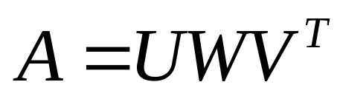
SVD - Basics
The SVD of a m-by-n matrix A is given by the formula :
Where :
U is a m-by-n matrix of the orthonormal eigenvectors of AA^{T}
V^{T} is the transpose of a n-by-n matrix containing the orthonormal eigenvectors of A^{T}A
W is a n-by-n Diagonal matrix of the singular values which are the square roots of the eigenvalues of A^{T}A
Notes:
Numerical Recipes explains how the SVD is used but does not explain how it is derived (At least not in chapter 2).

Slide 9
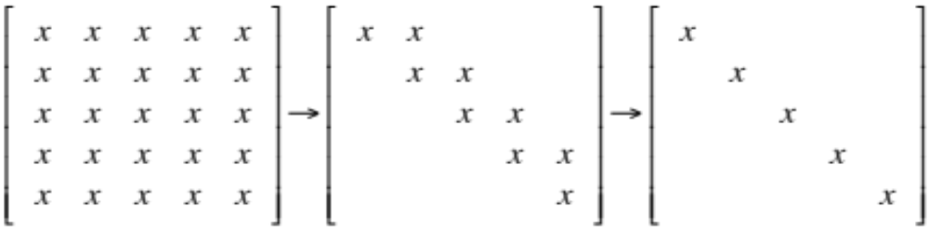
The Algorithm
Derivation of the SVD can be broken down into two major steps [2] :
    Reduce the initial matrix to bidiagonal form using Householder transformations
    Diagonalize the resulting matrix using QR transformations
Initial Matrix
Bidiagonal Form
Diagonal Form

Slide 10
Householder Transformations
A Householder matrix is a defined as :
    H = I – 2ww^{T}
Where w is a unit vector with |w|² = 1.
It ends up with the following properties :
    H = H^{T}
    H⁻¹ = H^{T}
    H² = I (Identity Matrix)
If multiplied by another matrix, it results in a new matrix with zero’ed elements in a selected row / column based on the values chosen for w.

Slide 11
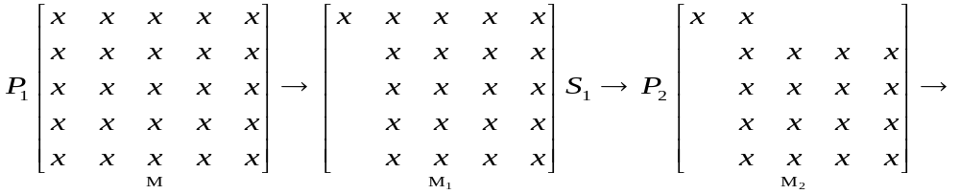
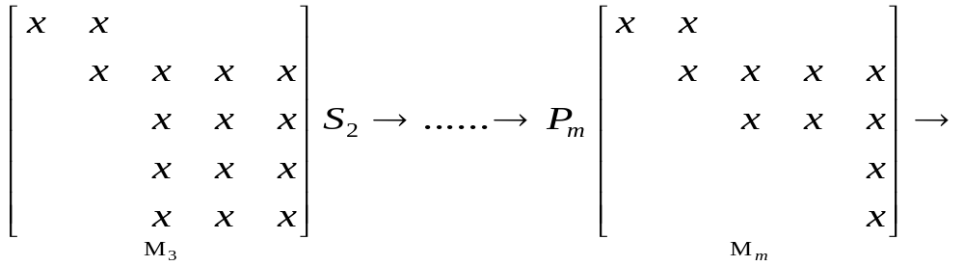
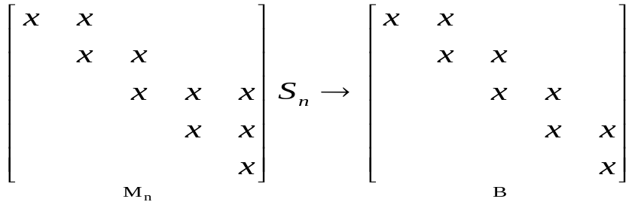
Applying Householder
To derive the bidiagonal matrix, we apply successive Householder matrices :

Slide 12
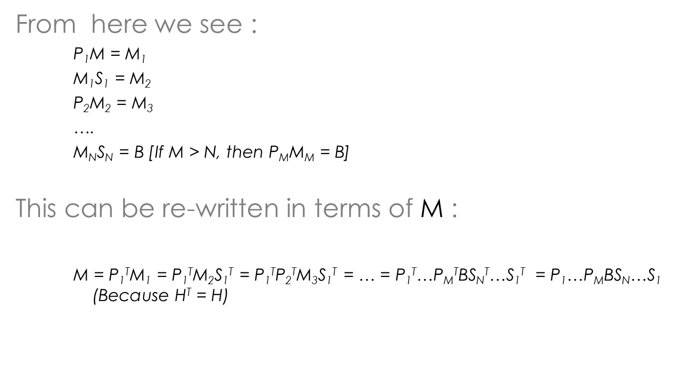
Application con’t

Slide 13
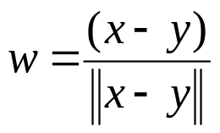

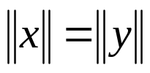

Householder Derivation
    Now that we’ve seen how Householder matrices are used, how do we get one? Going back to its definition : H = I – 2ww^{T}
    Which is defined in terms of w - which is defined as
    To make the Householder matrix useful, w must be derived from the column (or row) we want to transform.
    This is accomplished by setting x to row / column to transform and y to desired pattern.
and
and
(Length operator)

Slide 14
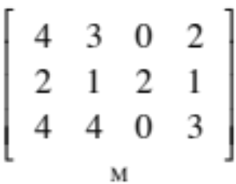
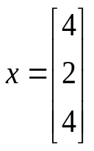
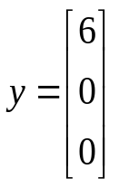


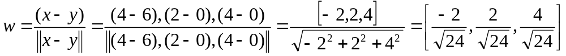
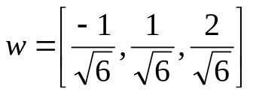
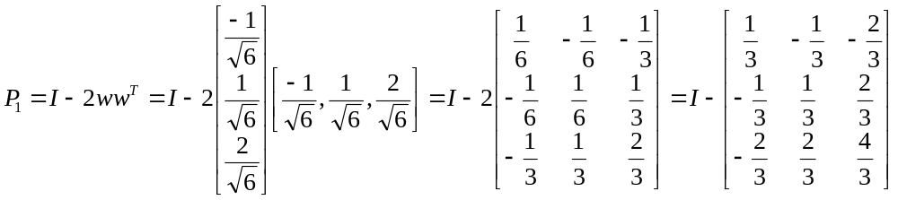
Householder Example
    To derive P₁ for the given matrix M :
    We would have :
With :
    This leads to :
    Simplifying :
    Then :

Slide 15
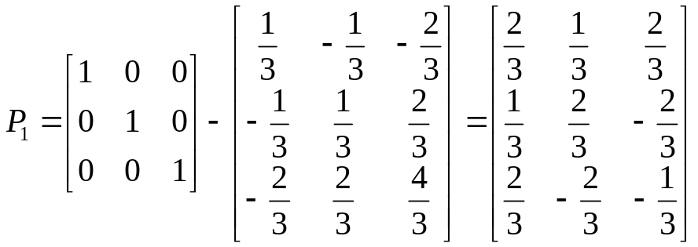
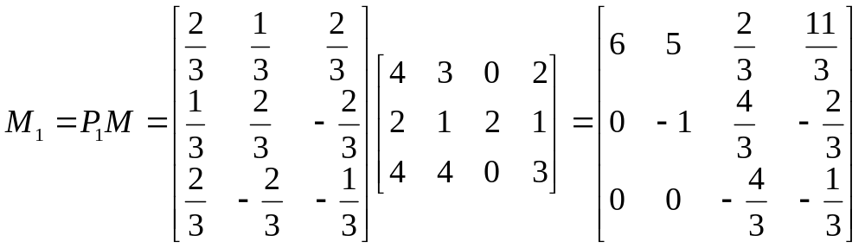
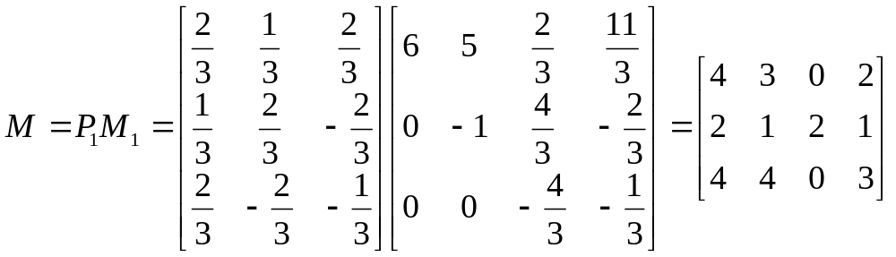
Example con’t
    Finally :
    With that :
    Which we can see zero’ed the first column.
    P₁ can be verified by performing the reverse operation :

Slide 16
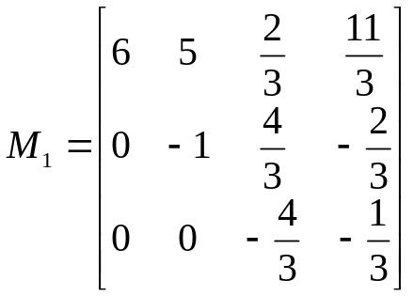
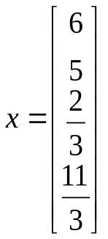
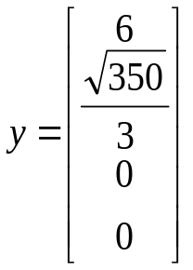
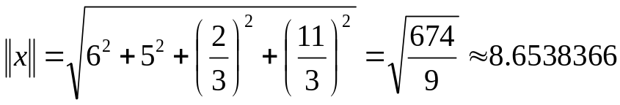
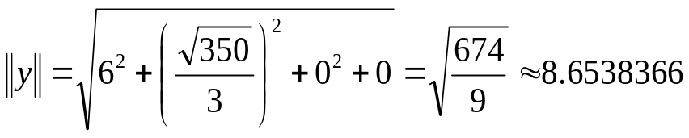
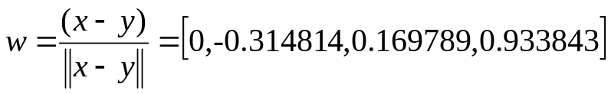
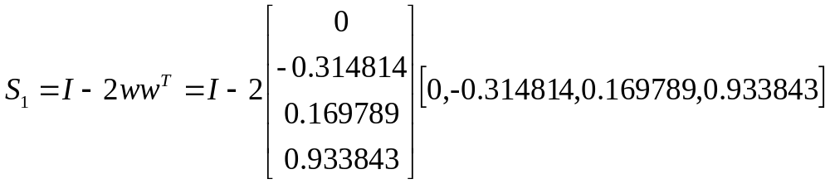
Example con’t
Likewise the calculation of S₁ for :
Would have :
With :
    This leads to :
    Then :

Slide 17
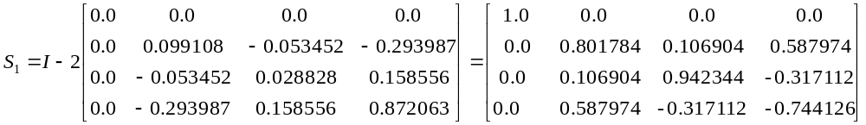
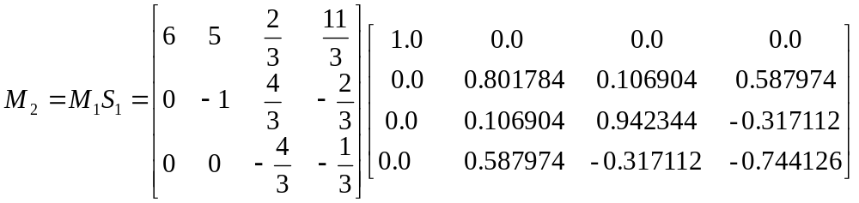
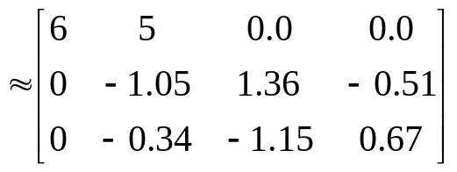
Example con’t
    Finally :
    With that :
    Which we can see zero’ed the first row.

Slide 18
The QR Algorithm
As seen, the initial matrix is placed into bidiagonal form which results in the following decomposition :
M = PBS with P = P₁...P_{N} and S = S_{N}…S₁
The next step takes B and converts it to the final diagonal form using successive QR transformations.

Slide 19
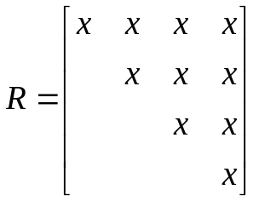
QR Decompositions
The QR decomposition is defined as :
    M = QR
Where Q is an orthogonal matrix (such that Q^{T} = Q⁻¹, Q^{T}Q = QQ^{T} = I)
And R is an upper triangular matrix :
It has the property such that RQ = M₁ to which another decomposition can be performed. Hence M₁ = Q₁R₁, R₁Q₁ = M₂ and so on. In practice, after enough decompositions, M_{x} will converge to the desired SVD diagonal matrix – W.

Slide 20

QR Decomposition con’t
Because Q is orthogonal (meaning QQ^{T} = Q^{T}Q = 1), we can redefine M_{x} in terms of Q_{x-1} and M_{x-1} only :
Which can be written as :
Starting with M₀= M, we can describe the entire decomposition of W as :
One question remains – How do we derive Q?
Multiple methods exist for QR decompositions – including Householder Transformations, Hessenberg Transformations, Given’s Rotations, Jacobi Transformations, etc.
Unfortunately the algorithm from book is not explicit on its chosen methodology – possibly Givens as it is used by reference material.
Notes:
Algorithm (Code) from the book leaves a lot to be desired (no comments and non-descriptive variables)

Slide 21
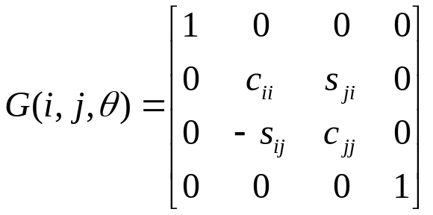


QR Decomposition using Givens rotations
A Givens rotation is used to rotate a plane about two coordinates axes and can be used to zero elements similar to the householder reflection.
It is represented by a matrix of the form :
The multiplication G^{T}A* effects only the rows i and j in A.
Likewise the multiplication AG only effects the columns i and j.
[1] Shows transpose on pre-multiply – but examples do not appear to be transposed (i.e. –s is still located i,j).

Slide 22
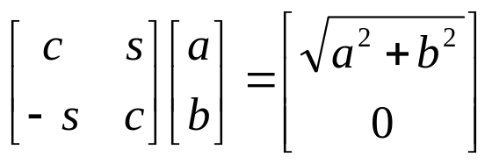
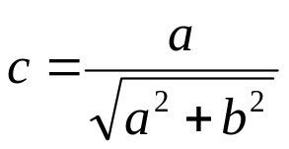
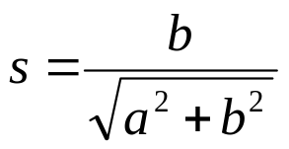
Givens rotation
The zeroing of an element is performed by computing the c and s in the following system.
Where b is the element being zeroed and a is next to b in the preceding column / row.
This is results in :

Slide 23
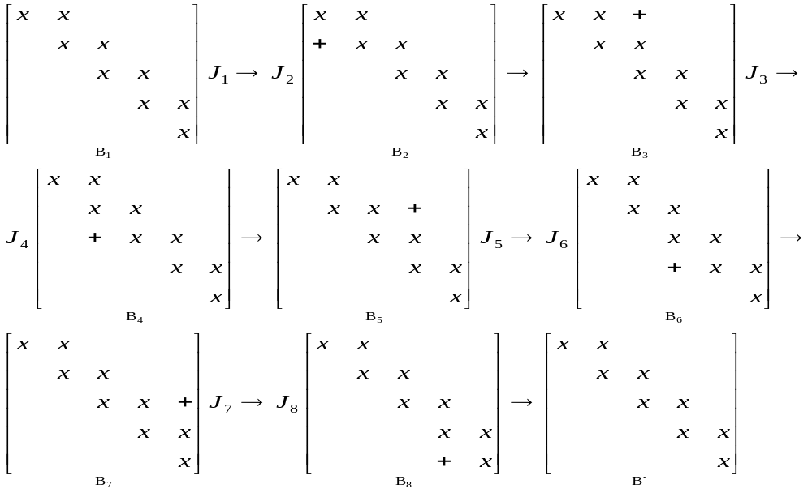
Givens rotation and the Bidiagonal matrix
The application of Givens rotations on a bidiagonal matrix looks like the following and results in its implicit QR decomposition.

Slide 24
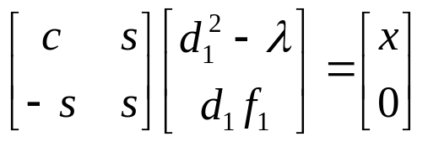
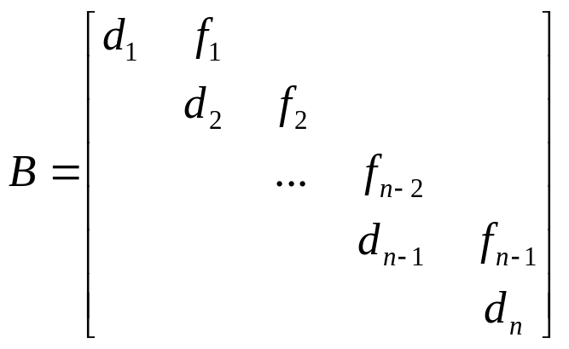
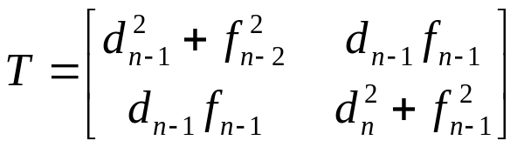
Givens and Bidiagonal
With the exception of J₁, J_{x} is the Givens matrix computed from the element being zeroed.
J₁ is computed from the following :
Which is derived from B and the smallest eigenvalue (λ) of T

Slide 25
Bidiagonal and QR
This computation of J₁ causes the implicit formation of B^{T}B which causes :

Slide 26
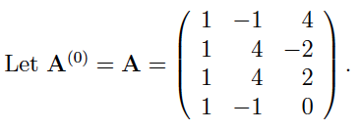
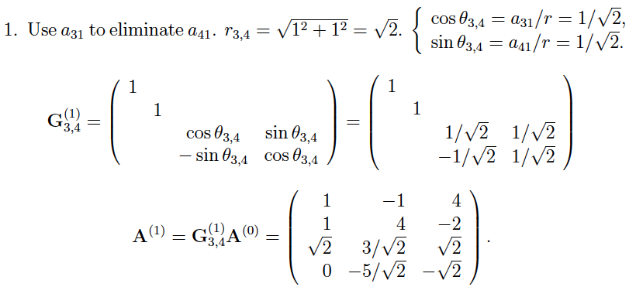

QR Decomposition Given's rotation example
Ref: An example of QR Decomposition, Che-Rung Lee, November 19, 2008

Slide 27
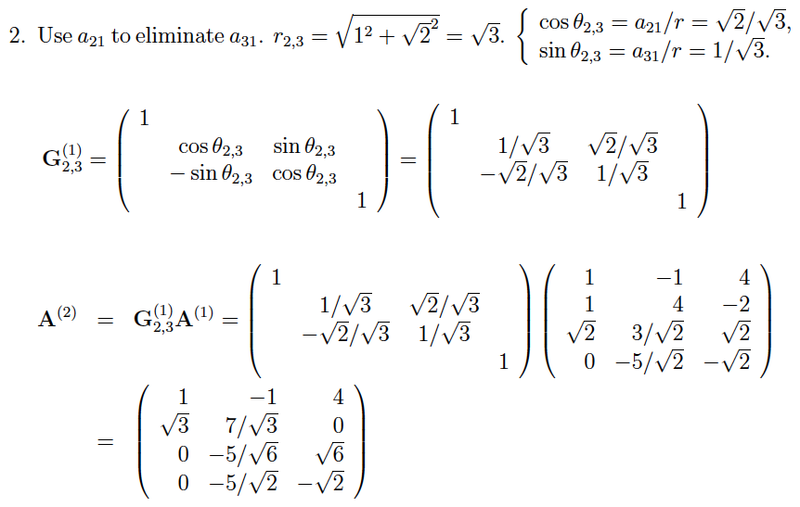

QR Decomposition Given's rotation example
Ref: An example of QR Decomposition, Che-Rung Lee, November 19, 2008

Slide 28
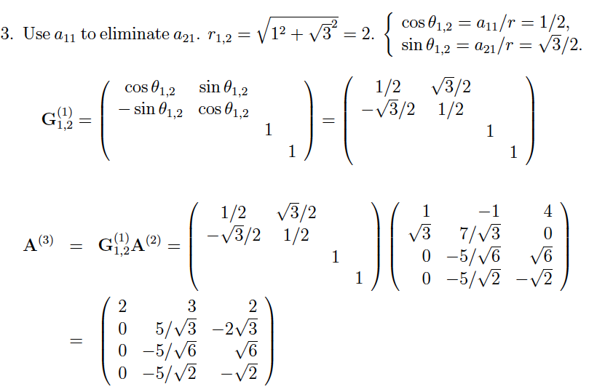

QR Decomposition Given's rotation example
Ref: An example of QR Decomposition, Che-Rung Lee, November 19, 2008

Slide 29
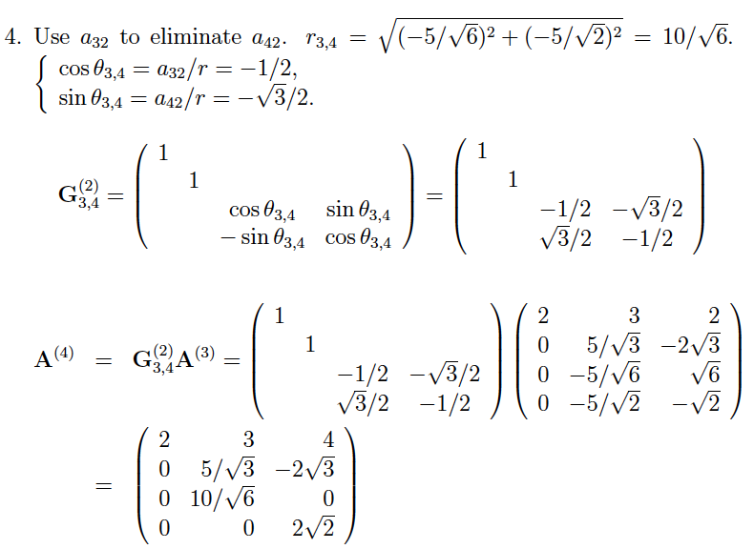

QR Decomposition Given's rotation example
Ref: An example of QR Decomposition, Che-Rung Lee, November 19, 2008

Slide 30
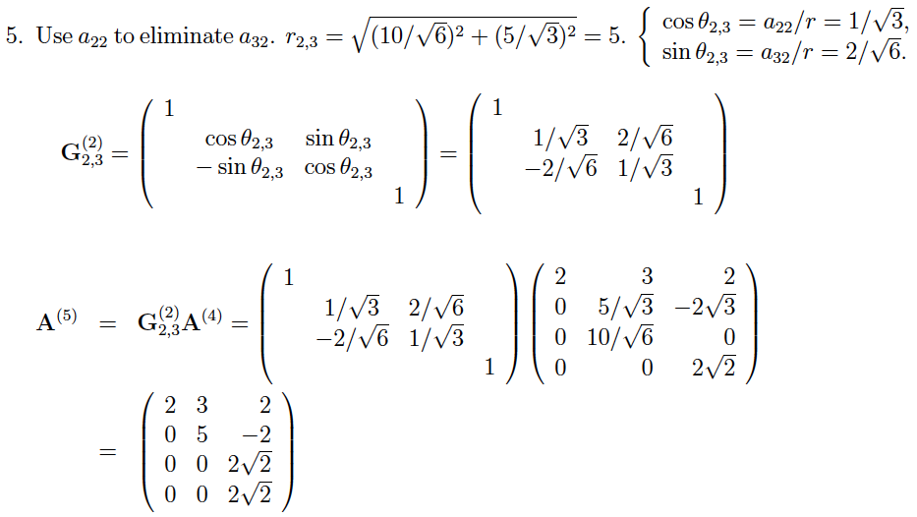

QR Decomposition Given's rotation example
Ref: An example of QR Decomposition, Che-Rung Lee, November 19, 2008

Slide 31
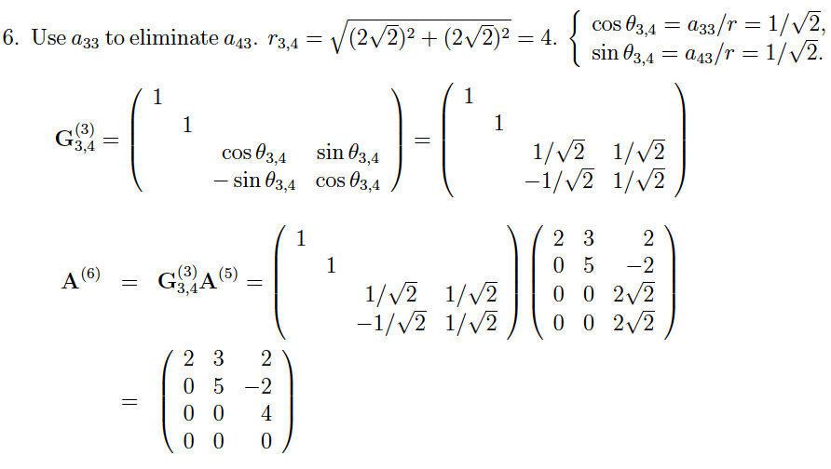
QR Decomposition Given's rotation example
Ref: An example of QR Decomposition, Che-Rung Lee, November 19, 2008

Slide 32
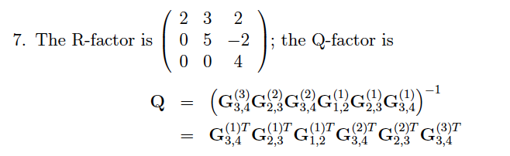
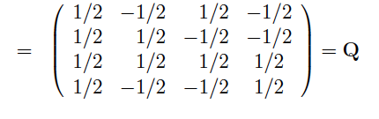
QR Decomposition Given's rotation example
Ref: An example of QR Decomposition, Che-Rung Lee, November 19, 2008

Slide 33






Putting it together - SVD
Starting from the beginning with a matrix M, we want to derive - UWV^{T}
Using Householder transformations :
[Step 1]
Using QR Decompositions :
[Step 2]
Substituting step 2 into 1 :
With U being derived from :
And V^{T} being derived from :
Which results in the final SVD :

Slide 34


SVD Applications
Calculation of the (pseudo) inverse :
[1] : Given
[2] : Multiply by M⁻¹
[3] : Multiply by V
[4]* : Multiply by W⁻¹
[5] : Multiply by U^{T}
[6] : Rearranging
*Note – Inverse of a diagonal matrix is diag(a₁,…,a_{n})⁻¹ = diag(1/a₁,…,1/a_{n})

Slide 35



SVD Applications con’t
Solving a set of homogenous linear equations i.e. Mx = b
Case 1 : b = 0
x is known as the nullspace of M which is defined as the set of all vectors that satisfy the equation Mx = 0. This is any column in V^{T} associated with a singular value (in W) equal to 0.
Case 2 : b != 0
Then we have :
Which can be re-written as :
From the previous slide we know :
Hence :
which is easily solvable

Slide 36
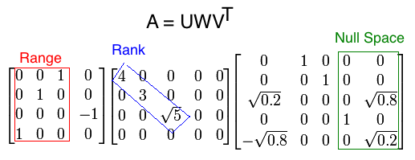
SVD Applications con’t
Rank, Range, and Null space
The rank of matrix A can be calculated from SVD by the number of nonzero singular values.
The range of matrix A is The left singular vectors of U corresponding to the non-zero singular values.
The null space of matrix A is The right singular vectors of V corresponding to the zeroed singular values.

Slide 37
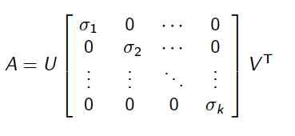

SVD Applications con’t
Condition number
SVD can tell How close a square matrix A is to be singular.
The ratio of the largest singular value to the smallest singular value can tell us how close a matrix is to be singular:
A is singular if c is infinite.
A is ill-conditioned if c is too large (machine dependent).

Slide 38

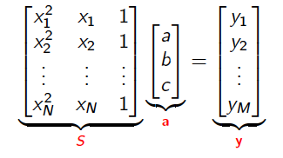

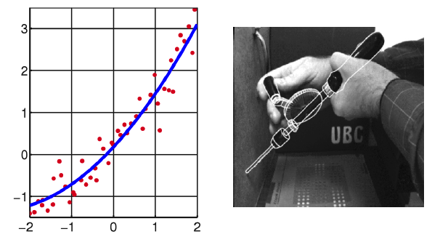
SVD Applications con’t
Data Fitting Problem

Slide 39
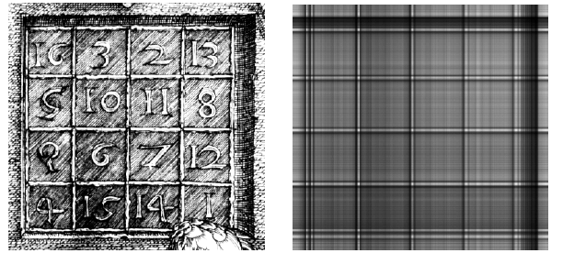
SVD Applications con’t
Image processing
[U,W,V]=svd(A)
NewImg=U(:,1)*W(1,1)*V(:,1)’

Slide 40
SVD Applications con’t
Digital Signal Processing (DSP)
SVD is used as a method for noise reduction.
Let a matrix A represent the noisy signal:
  compute the SVD,
  and then discard small singular values of A.
It can be shown that the small singular values mainly represent the noise, and thus the rank-k matrix A_{k} represents a filtered signal with less noise.

Slide 41
Additional References
Golub & Van Loan – Matrix Computations; 3rd Edition, 1996
Golub & Kahan – Calculating the Singular Values and Pseudo-Inverse of a Matrix; SIAM Journal for Numerical Analysis; Vol. 2, #2; 1965
An Example of QR Decomposition, Che-Rung Lee, November 19, 2008

